Slide 1
Computer Vision
Adversarial Attacks against Image Classifiers
Landon Moon Parker Steach
Gilbert Lavin Justin Fellows
Speaker: Landon Moon

Slide 2
Basic Concept
What are we trying to do
Speaker: Landon Moon

Slide 3
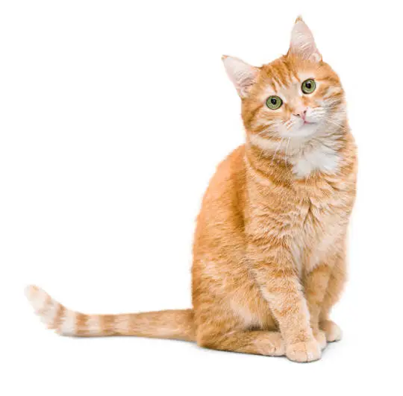
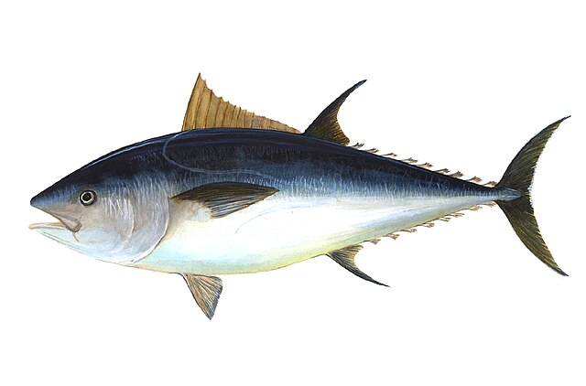
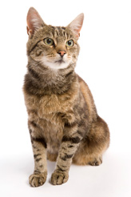
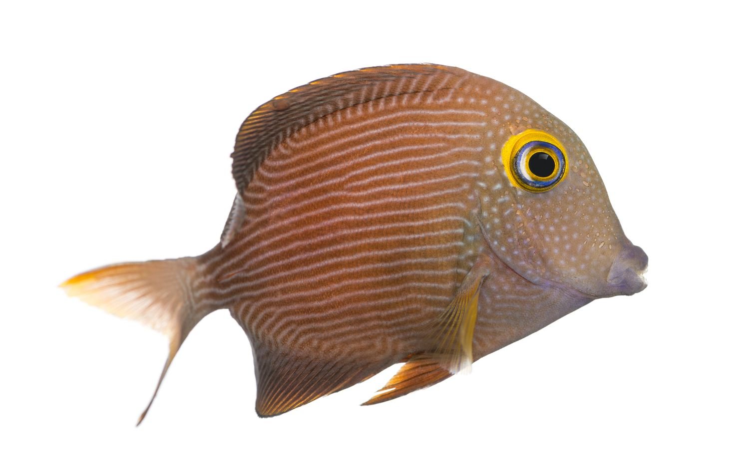
General Idea
Image classifiers are used to determine what is shown in an image.
Attacks against image classifiers force images to be classified incorrectly.
By attacking an image classifier, an image that looks like a cat can be classified as something else
Correct
Cat
Fish
Attacked
Fish
Dog
Speaker: Landon Moon

Slide 4
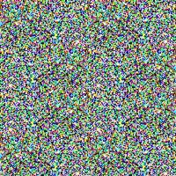
Changing Classified Images
How it works
These attacks are done by making slight changes to correctly classified images.
The changes are deliberate and purposeful, so the classifier is tricked, but the image still looks the same to humans.
Fish
Cat
Dog
Fish
Speaker: Landon Moon

Slide 5

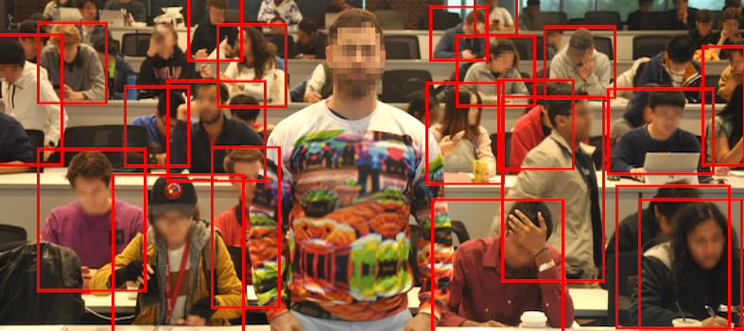
Obscuring Physical Objects
How it works
Some datasets do not contain enough images to cover the edge cases for an image classifier. These classifiers can be attacked by making a small change to the object that was not present in the dataset.
Results depend on how robust the image classifier was made. This emphasizes the importance of large datasets that cover as many cases as possible.
Stop Sign
Yield Sign
Source: arXiv:1910.14667
Speaker: Landon Moon

Slide 6
Summary of Research
What have others found out
Speaker: Parker Steach

Slide 7
Types of Attacks
White Box Attack
full internal access
Knows all weights, parameters, hyperparameters, model, etc.
Gray Box Attack
some internal access
Might know the dataset but not the classification error, etc.
Black Box Attack
no internal access
Knows nothing except classification label.
Inputs
Black Box
Outputs
Speaker: Parker Steach

Slide 8
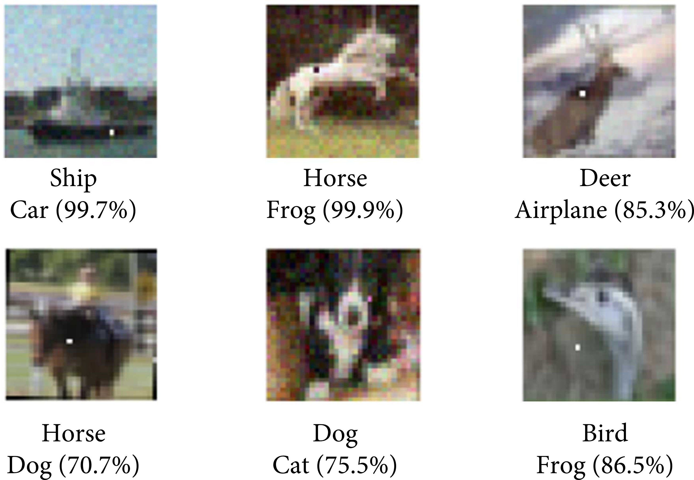
One Pixel Attacks
Black Box Attack
Just change a single pixel, usually to either black or white. This causes the classifier to misinterpret the image.
Has been noted that nearby pixels “share the same susceptibility, showing that neither neurons nor pixels are the primary sources of vulnerability but rather the receptive fields.”
30% success rate on cifar-10
16% success rate on ImageNet
Source: 10.1109/TEVC.2019.2890858
Speaker: Parker Steach

Slide 9
One Pixel Attacks
Prevention
These attacks can be detected. Because one pixel is very different from its neighbors, a model can be designed to identify and correct 'incorrect' pixels.
Alternatively, the original image classifier can be trained on these kinds of attacks through data augmentation.
Source: 10.1109/TEVC.2019.2890858
Speaker: Parker Steach

Slide 10
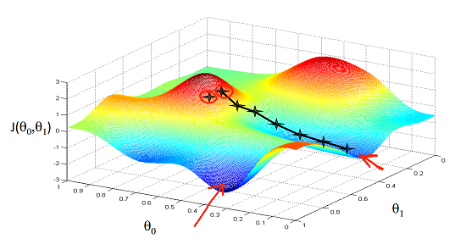
Undetectable Attacks
White Box Attack
Applies a “perturbation” vector to the image. This vector is generated by traveling in the direction of most loss with respect to the original label. The loss becomes greatest when the image is better classified as another label.
Repeatedly apply this new gradient vector to the perturbation vector until the loss with respect to the original label skyrockets.
step: 0, loss: -0.0035399647895246744...
step: 5, loss: -0.06135868281126022...
step: 10, loss: -0.961777925491333...
step: 15, loss: -3.0897696018218994...
step: 20, loss: -8.585610389709473...
step: 25, loss: -18.563501358032227...
step: 30, loss: -27.948774337768555...
step: 35, loss: -36.7973747253418...
step: 40, loss: -44.854835510253906...
step: 45, loss: -52.91378402709961...
Loss is calculated as negative to go against the gradient towards a different label.
Speaker: Justin Fellows

Slide 11

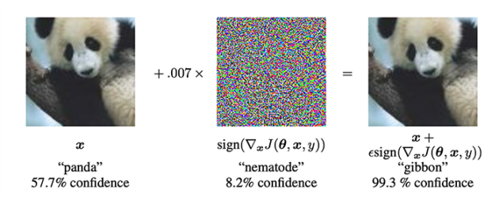
Undetectable Attacks
Prevention
Prevent access to the loss function when classifying an image. This prevents calculating the perturbation vector. AKA prevent a white box attack.
No amount of training, increase in dataset size, or model changes can prevent this kind of attack. Due to its execution, if the attacker knows the internals of the model, it can always be executed.
Speaker: Justin Fellows

Slide 12
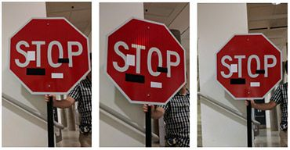
Physical attacks on images
Black Box Attack
Placing black and White tape of stop signs to fool an image classifier. Because some classifiers are not trained on these types of images, they are foreign and misclassified.
A researcher said that "It's probably not safe to assume that attacks like these won't ever work, though, because even the most sophisticated deep neural network-based algorithms can be really, really dumb at times."
https://spectrum.ieee.org/slight-street-sign-modifications-can-fool-machine-learning-algorithms
Speaker: Gilbert Lavin

Slide 13
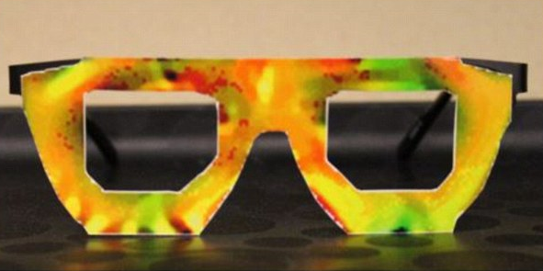
Physical attacks on images
Prevention
Train the model on a dataset with these attacks on some of the images. This can be difficult to due because the dataset needs to be made with this in mind. Making large datasets is not easy.
Apply data-augmentation to the image set to add different kinds of noise like these attacks. This is a simple solution that can be done in software after the original dataset is collected.
https://www.dailymail.co.uk/sciencetech/article-3898508/Spot-difference-facial-recognition-systems-t-bizarre-face-stealing-specs-fool-AIs-thinking-else.html
Speaker: Gilbert Lavin

Slide 14
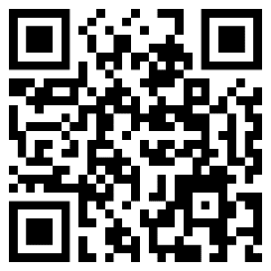
Demonstration of Existing Work
Demo of ‘Changing Classified Images’
Speaker: Landon Moon

Slide 15
Questions?
Adversarial Attacks against Image Classifiers
Speaker: Landon Moon

Slide 16
References
pyimagesearch.com/2020/10/19/adversarial-images-and-attacks-with-keras-and-tensorflow/
www.ncbi.nlm.nih.gov/pmc/articles/PMC10487122/
www.sciencedirect.com/science/article/abs/pii/S0167404821002443
www.hindawi.com/journals/wcmc/2021/8891204/

Slide 17
References Cont.
arxiv.org/abs/1910.14667
arxiv.org/abs/1807.07769
https://spectrum.ieee.org/slight-street-sign-modifications-can-fool-machine-learning-algorithms
https://spectrum.ieee.org/slight-street-sign-modifications-can-fool-machine-learning-algorithms

